Slide 1
Data Science
CSE-4075
(Gradient Descent)

Slide 2
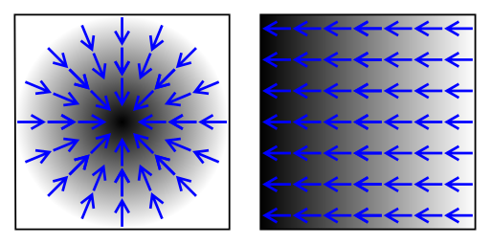
Preliminaries
The gradient is a vector-valued function, as opposed to a derivative, which is scalar-valued. Like the derivative, the gradient represents the slope of the tangent of the graph of the function.
The gradient points in the direction of the greatest rate of increase of the function, and its magnitude is the slope of the graph in that direction.

Slide 3


Preliminaries
In mathematics, computer science and operations research, mathematical optimization or mathematical programming, is the selection of a best element (with regard to some criterion) from some set of available alternatives.
The minimum value will be 1.
The maximum value will be infinity.

Slide 4
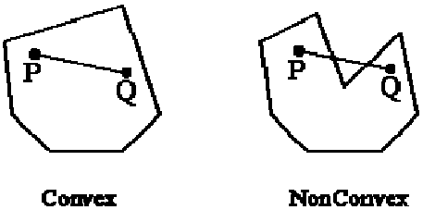
Preliminaries
In mathematics, a real-valued function defined on an n-dimensional interval is called convex, if the line segment between any two points on the graph of the function lies above or on the graph, in a Euclidean space (or more generally a vector space) of at least two dimensions.

Slide 5
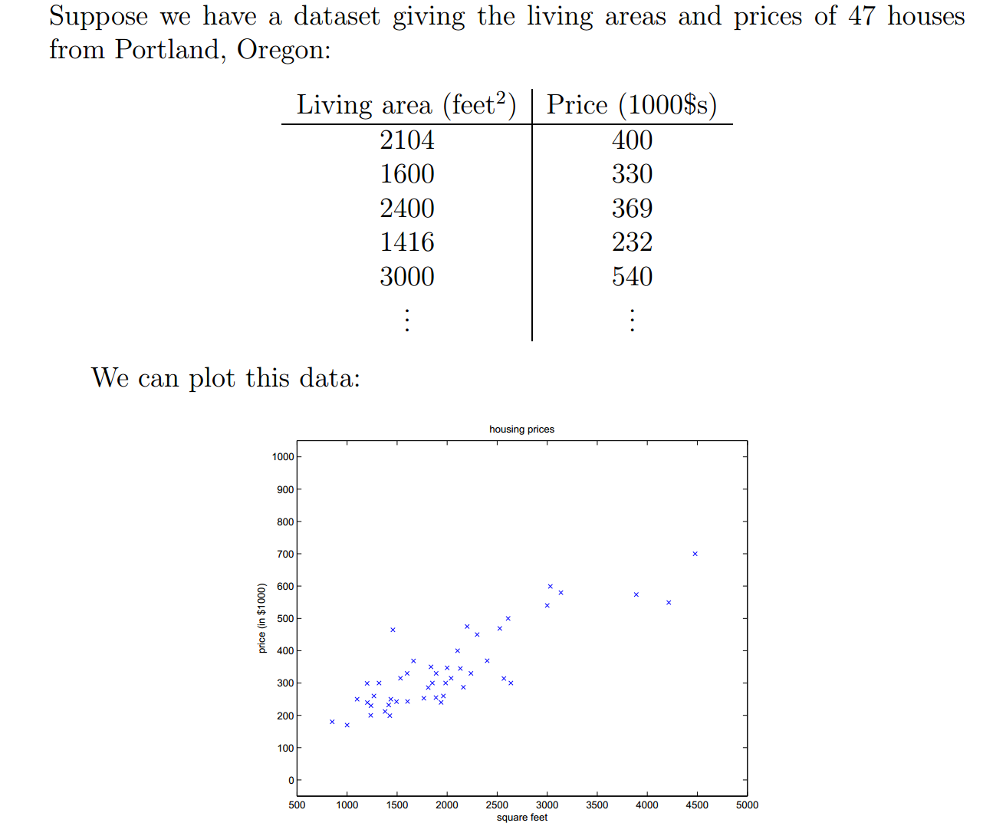
Supervised Learning

Slide 6
Notations
x^{(i)} to denote the “input” variables (living area in this example), also called input features
y^{(i)} to denote the “output” or target variable that we are trying to predict (price).
A pair (x^{(i),} y^{(i)}) is called a training example
List of m training examples {(x^{(i)}, y^{(i)}); i =1, . . . , m}—is called a training set.
Given a training set, to learn a function h : X → Y so that h(x) is a “good” predictor for the corresponding value of y. h is called a hypothesis.

Slide 7
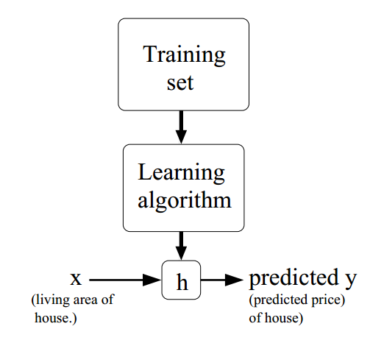
Supervised Learning
When the target variable to predict is continuous, we call the learning problem a regression problem.
When y can take on only a small number of discrete values, we call it a classification problem.

Slide 8
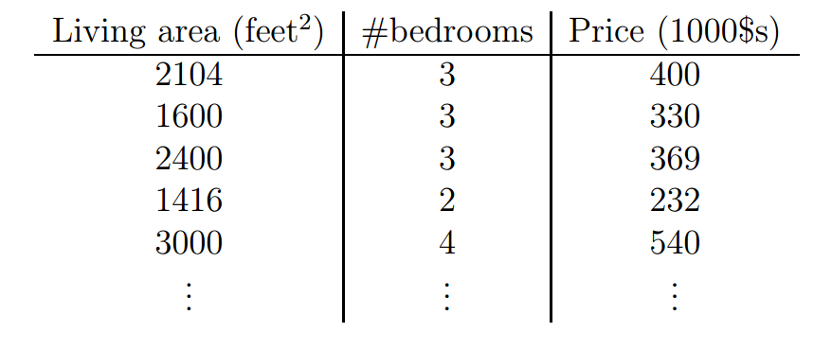
Linear Regression

Slide 9

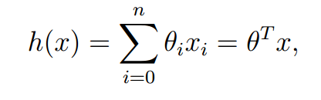
Linear Regression
As an initial choice, we decide to approximate y as a linear function of x:
θ_{i}’s are the parameters (also called weights) parameterizing the space of linear functions mapping from X to Y.

Slide 10
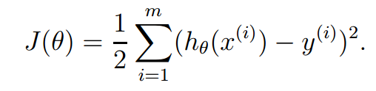
Linear Regression
Given a training set, how do we pick, or learn, the parameters θ?
The cost function is defined as:
It is required to choose θ so as to minimize J(θ).
To search algorithm that starts with some “initial guess” for θ, and that repeatedly changes θ to make J(θ) smaller, until hopefully we converge to a value of θ that minimizes J(θ).

Slide 11
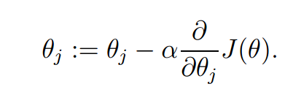
Gradient Descent
The gradient descent algorithm starts with some initial θ, and repeatedly performs the update:
This update is simultaneously performed for all values of j = 0, . . . , n.
Here, α is called the learning rate. This is a very natural algorithm that repeatedly takes a step in the direction of steepest decrease of J

Slide 12
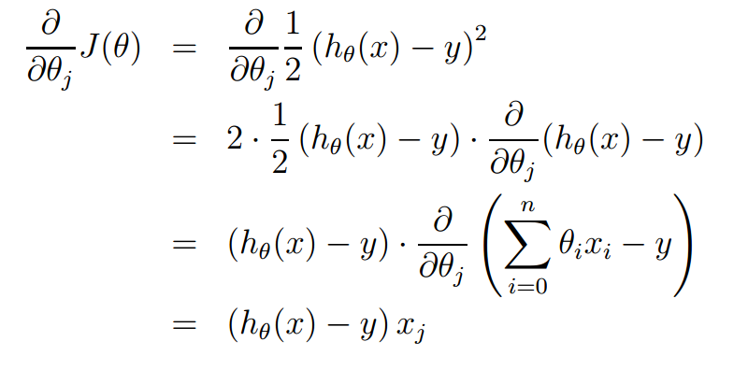

Gradient Descent
For the case of if we have only one training example (x, y), so that we can neglect
the sum in the definition of J. We have:
For a single training example, this gives the update rule called Least mean Square:

Slide 13
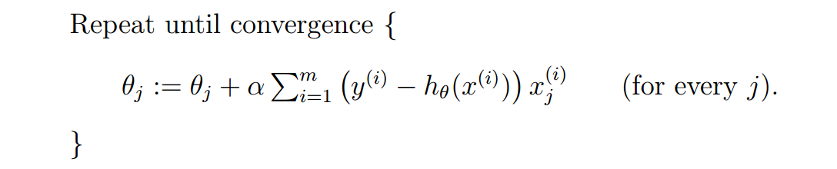
Gradient Descent
For more than one training example:
This is called batch gradient descent.

Slide 14
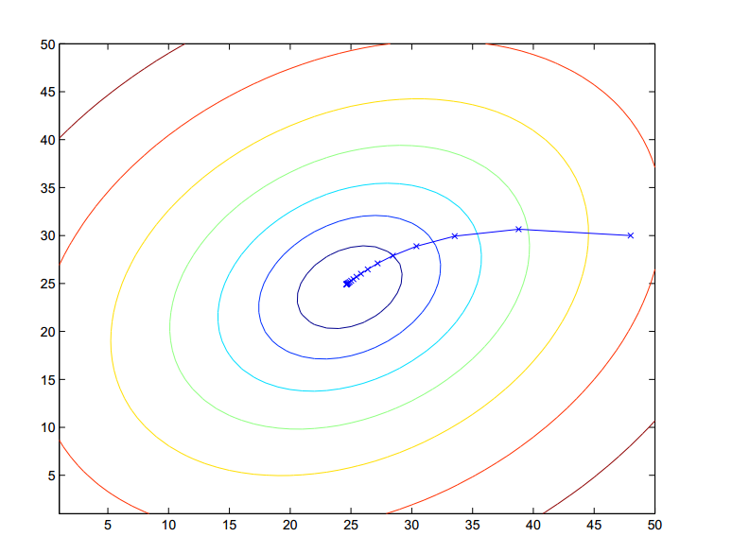
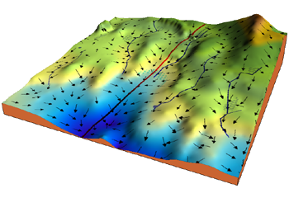
Gradient Descent

Slide 15
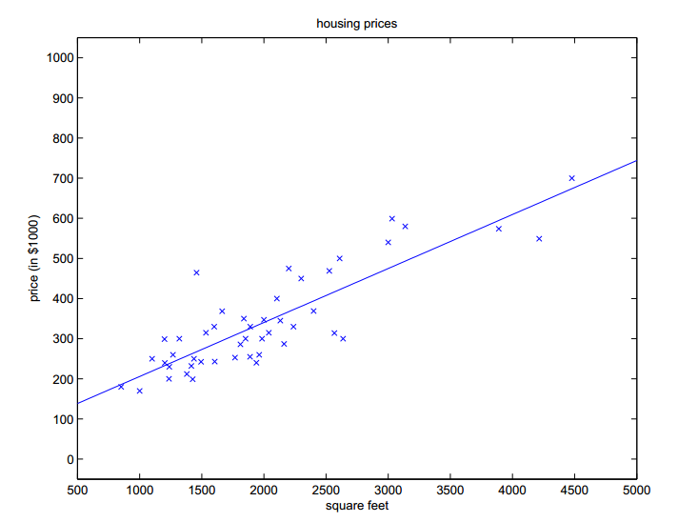
Gradient Descent
When we run batch gradient descent to fit θ on our previous dataset,
to learn to predict housing price as a function of living area, we obtain
θ₀ = 71.27, θ₁ = 0.1345.
If the number of bedrooms were included as one of the input features as well, we get θ0 = 89.60, θ1 = 0.1392, θ2 = −8.738.

Slide 16
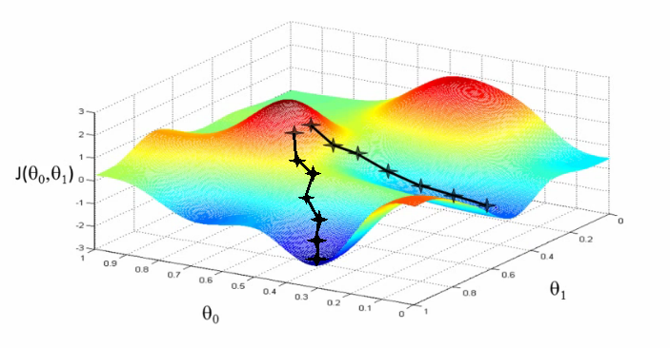
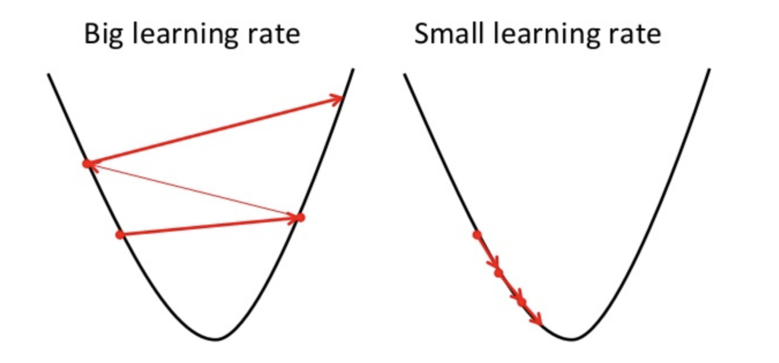
Pros and cons of gradient descent
Simple and often quite effective on ML tasks
Often very scalable
Only applies to smooth functions (differentiable)
Might find a local minimum, rather than a global one

Slide 17
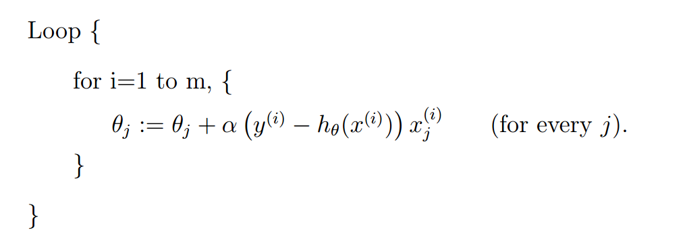
Stochastic Gradient Descent
In this algorithm, we repeatedly run through the training set, and each time, we encounter a training example, we update the parameters according to, the gradient of the error with respect to that single training example only.

